Slide 1
“LONG READS”
Claude THERMES
PLATEFORME DE SÉQUENÇAGE I2BC
INSTITUT DE BILOGIE INTÉGRATIVE DE LA CELLULE
GIF-SUR-YVETTE
9^{ème} ÉCOLE DE BIOINFORMATIQUE EBAII - 06/10/2020

Slide 2
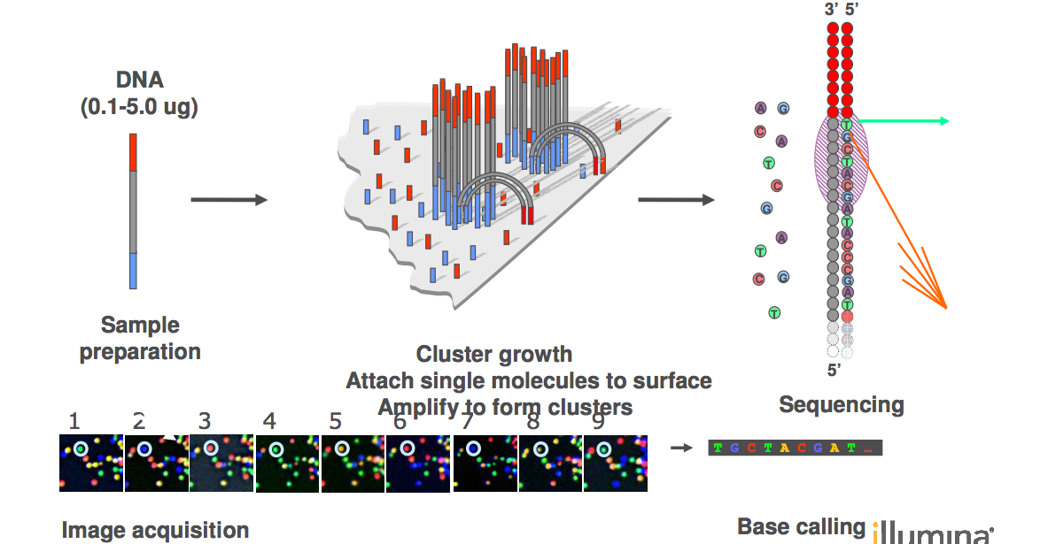
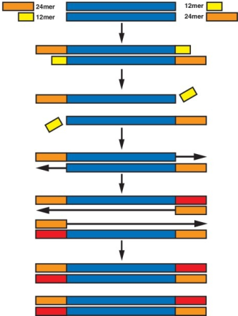
WHY ILLUMINA READS ARE SO SHORT (≤ 300 NT) ?
General scheme of Illumina sequencing
1
2
3
Preparation of
DNA libraries
Cluster growth
Sequencing
by synthesis

Slide 3
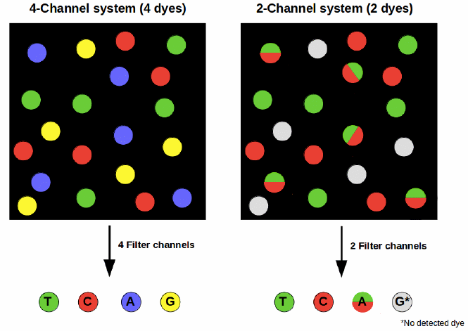
SEQUENCING QUALITY
4-channel vs 2-channel detection
MiSeq, HiSeq 4000 and X
MiniSeq, NextSeq, NovaSeq
2-channel detection can cause sequencing errors due to phasing issues
and can cause polyG tracts at the end of fragments

Slide 4
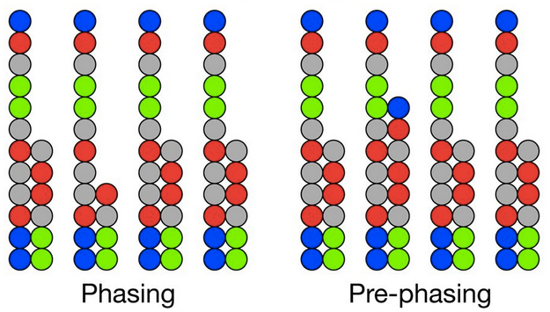
SEQUENCING QUALITY
Phasing/Prephasing
Q-score
Percentages of bases that fell behind or jumped ahead the current cycle within a read. It increases with cycle number, hampering correct base identification for long reads. Optimal values are below 0.5 or 0.2% depending on platform. Issues may arise when read length is above specifications.
Base calling error probabilities P : Q = − 10 log₁₀ P
% Q-score > 30 : percentage of bases that have a a probability of incorrect base calling of 1/1000. Low Q scores can increase false-positive variant calls, which can result in inaccurate conclusions.

Slide 5
A NEWCOMER IN SHORT READ SEQUENCING
(acquisition of Complete Genomics in 2013)

Slide 6
NEW SEQUENCING TECHNOLOGY
Tests préliminaires (Genoscope, CNRGH)
Qualité : Q30 moyen élevé (même en 2x200)
Taux d’erreur MGI < taux d’erreur NovaSeq
% reads mappés MGI > % reads mappés Illumina
Mais :
Runs plus longs (+ lavage 6h)
Preparation of nanoballs « délicate »
Régions riches A/T et G/C moins couvertes
G400 NovaSeq S1 NovaSeq S4
Run time 66h 24h 48h
Output 500 Gb 500 Gb 1600-2000 Gb
Cost/Gb (€) 3.8 - 4.5 9.9 - 12.4 6.6 - 8.3

Slide 7
LONG-READS VERSUS SHORT-READS
Assembly of DNA fragments with repeated sequences
NGS short reads assembly
Several contigs incomplete assembly, underestimation of repeats
Long reads assembly

Slide 8
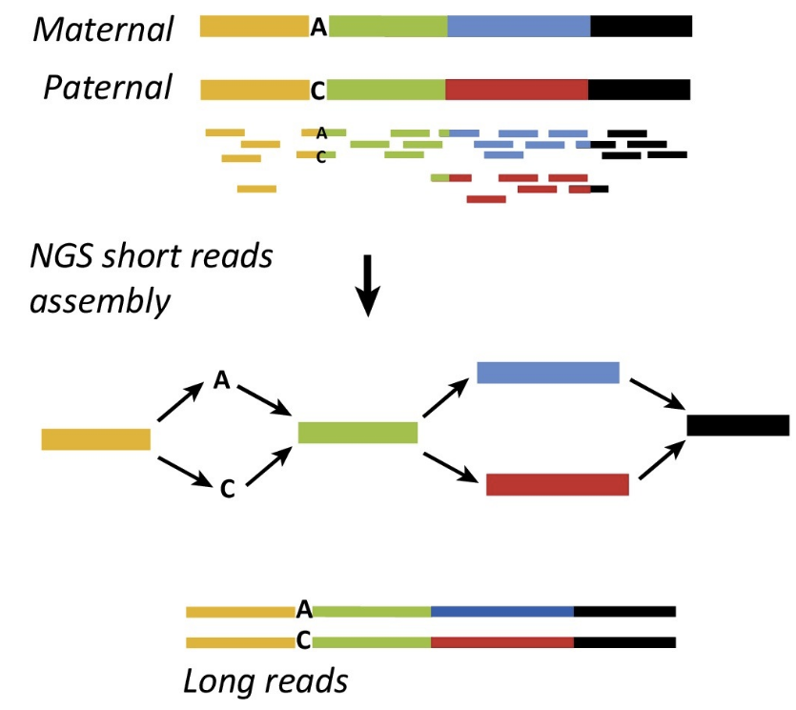
LONG-READS VERSUS SHORT-READS
Haplotype phasing
T
G
T
G
T
G

Slide 9
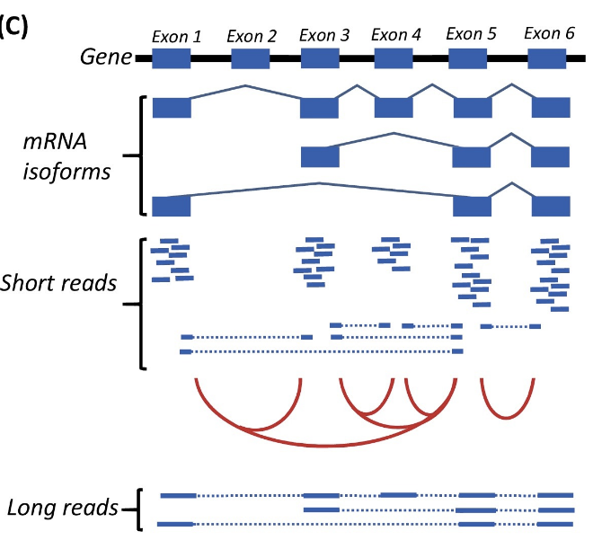
LONG-READS VERSUS SHORT-READS
Detection of splicing isoforms

Slide 10
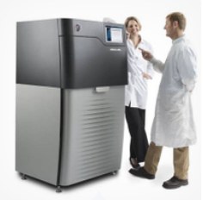
The 3rd generation
winning technologies
Sequel - Pacific Biosciences
Single molecules
Up to 80,000 bp long
Error rate ≈ 10-15 % - CCS: <1%
Compensated by coverage
MinION - Oxford Nanopore
Single molecules
> 200 000 bp long
Error rate ≈ 10-15 %
Compensated by coverage

Slide 11
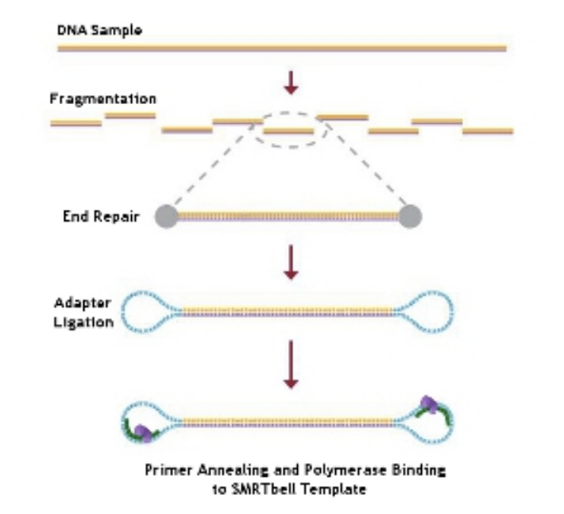
PacBio : Single Molecule Real Time (SMRT) sequencing
PacBio DNA-seq library

Slide 12
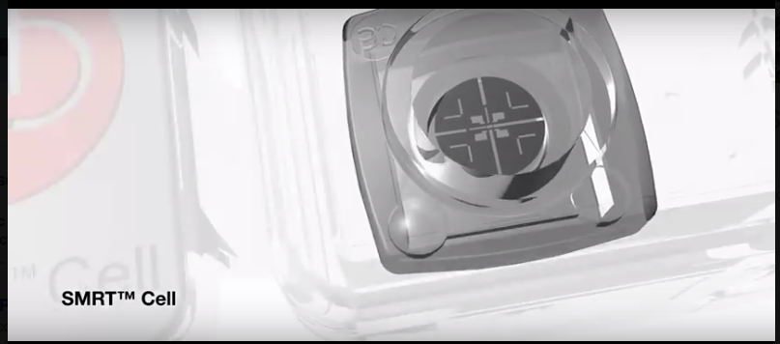
Pacific Biosciences
ZMW

Slide 13
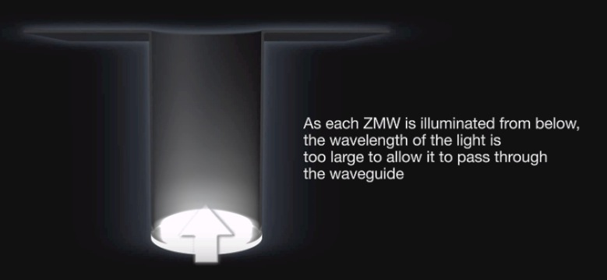
Pacific Biosciences
ZMW : optical waveguide that guides light energy into a volume that is small compared to the wavelength of the light

Slide 14
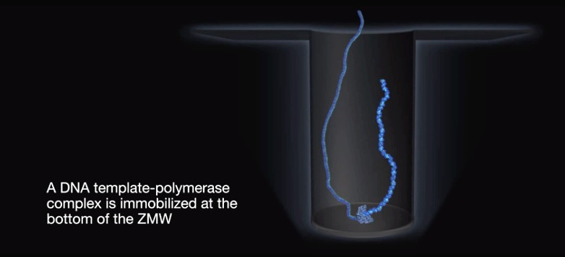
Pacific Biosciences

Slide 15
Pacific Biosciences

Slide 16
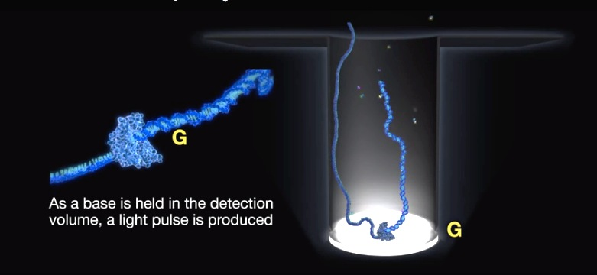
Pacific Biosciences

Slide 17
Pacific Biosciences

Slide 18
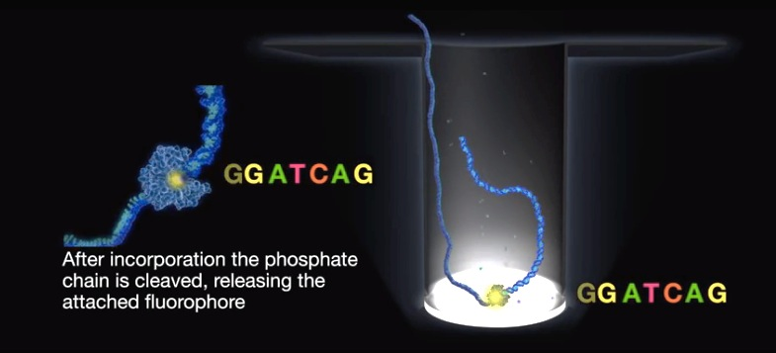
Pacific Biosciences

Slide 19
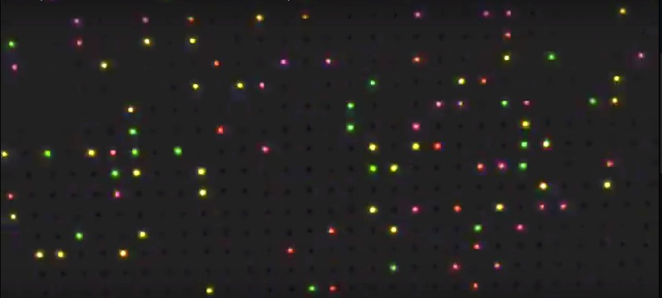

Slide 20
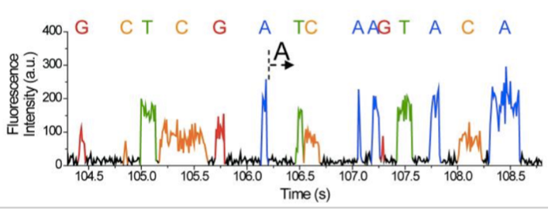

Slide 21
Improvement with new chemistry : Circular Consensus Sequence (CCS)
Pacific Biosciences
Circular consensus sequencing (CCS) reads are obtained when the SMRT bell template is replicated several times by the polymerase
This allows a highly accurate sequencing by correction of random errors

Slide 22
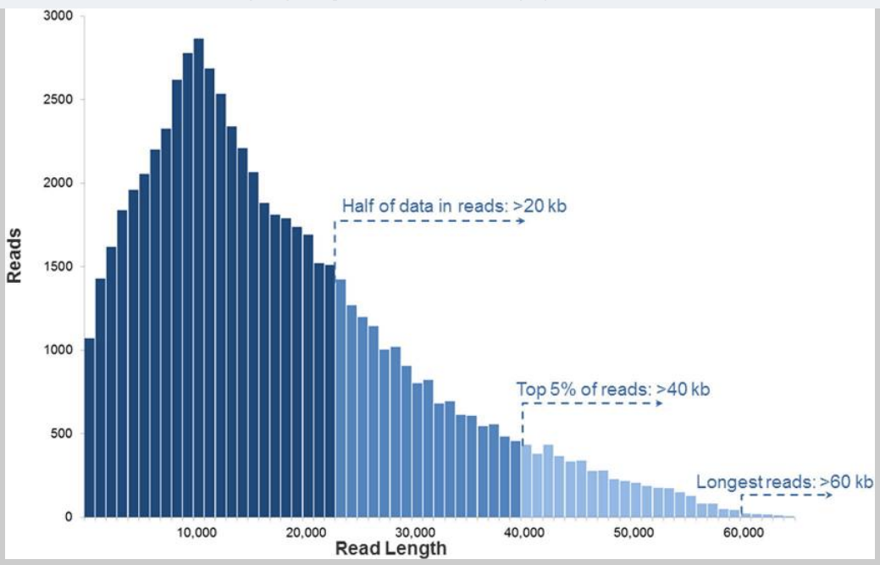
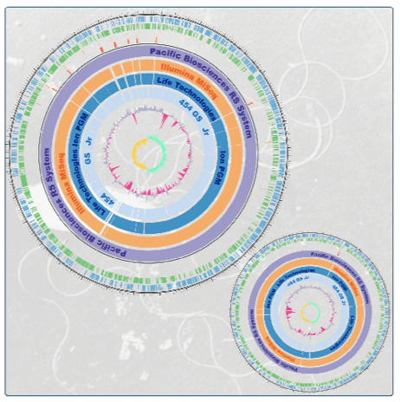
Length of PacBio reads
2015
(Rhoads, Genomics Proteomics Bioinformatics, 2015)
Half of reads > 20 kb
Top 5% of reads > 40 kb
Longest reads > 40 kb
Genome assembly
De novo assembly of Vibrio parahaemolyticus (5 Mb): two circular chromosomes
Miyamoto et al. BMC Genomics (2014)

Slide 23
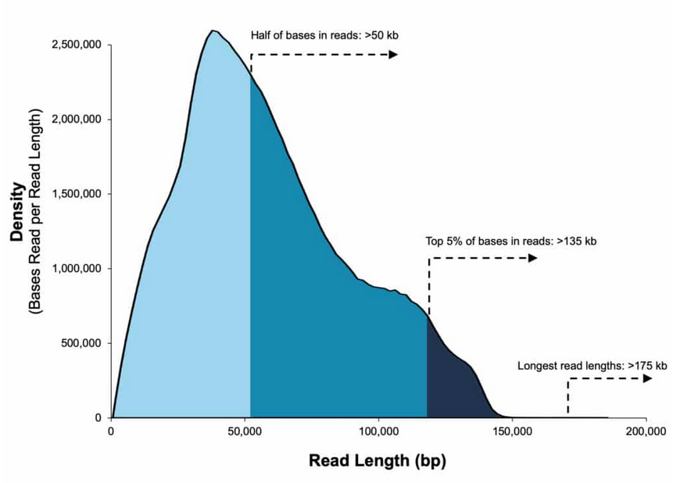
Length of PacBio reads
2015
(Rhoads, Genomics Proteomics Bioinformatics, 2015)
Half of reads > 20 kb
Top 5% of reads > 40 kb
Longest reads > 40 kb
Half of reads > 50 kb
2019
Data from 35 kb size-selected E. coli library
Sequel II System ; 2.0 Chemistry
Top 5% of reads > 135 kb
Longest reads > 175 kb

Slide 24
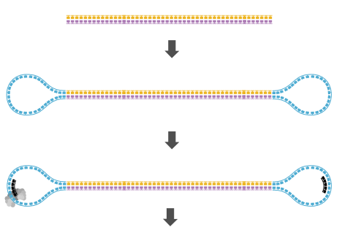
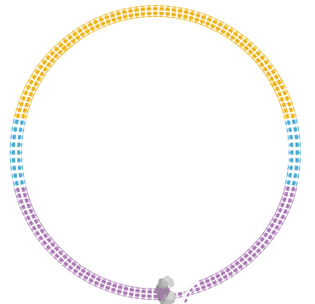
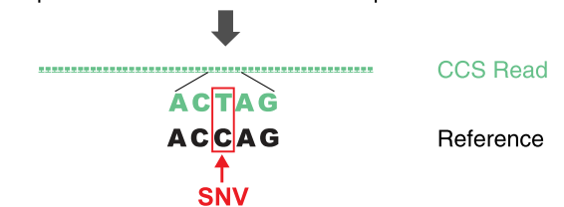
Circular Consensus Sequences (CCS): HIFI READS

Slide 25
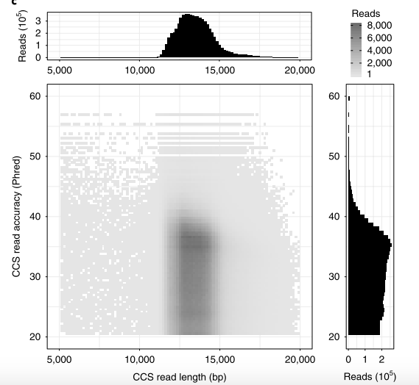
Genome assembly with CCS
Circular consensus assembly of a human genome
Wenger et al. Nat. Biotechnol. oct. 2019

Slide 26
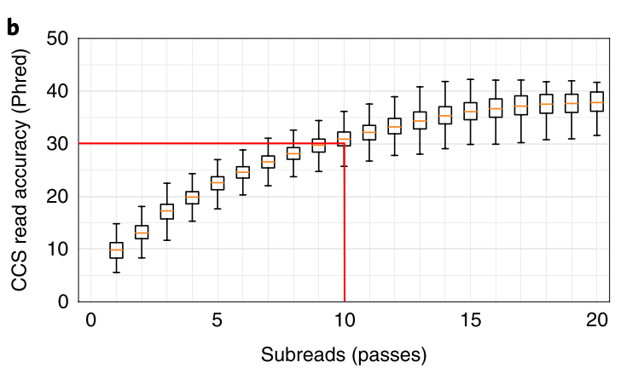
Genome assembly with CCS
Circular consensus assembly of a human genome
Wenger et al. Nat. Biotechnol. (2019)

Slide 27
Genome assembly with CCS
Circular consensus assembly of a human genome
Wenger et al. Nat. Biotechnol. oct. 2019
CCS reads alone : high quality contiguous genome : concordance of 99.997%
Canu assembly
genome size > expected haploid genome because it resolves some heterozygous alleles into separate contigs
Majority of CCS read discordances
3.4% mismatches 1 mismatch every 13,048 bp
4.6% indels in non homopolymers. 1 non-homopolymer indel every 9,669 bp
92.0% indels in homopolymers 1 homopolymer indel every 477 bp
Comparison with NovaSeq
CCS mismatch rate is 17× lower than reads from NovaSeq
CCS indel rate is 181× higher than reads from NovaSeq

Slide 28
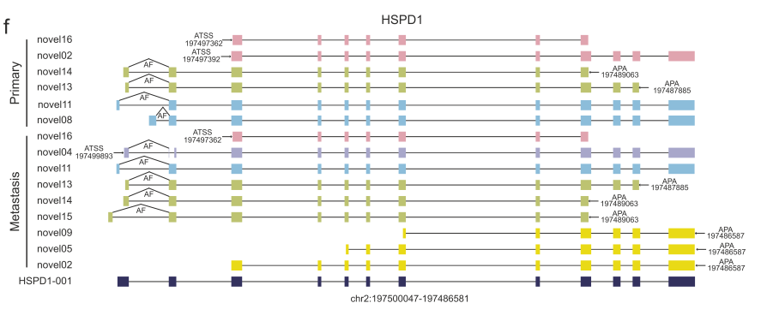
cDNA SEQUENCING
Hybrid full-length transcriptome in metastatic ovarian cancer
Jing et al. Oncogene 2019
Primary
tumor
Metastases
Long-read full-length transcriptome analysis
improves molecular diagnostic
reveals novel therapeutic vulnerabilities

Slide 29
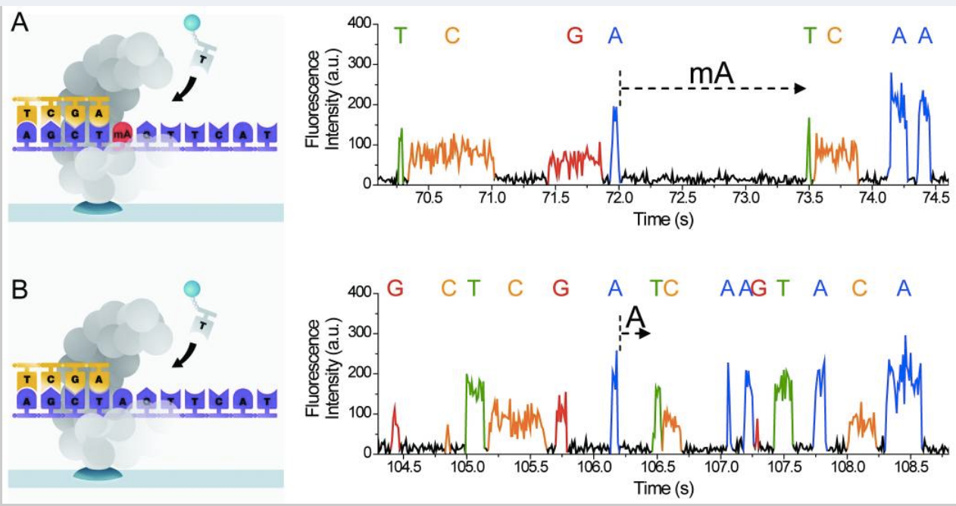
DETECTION OF MODIFIED BASES
from Fusberg et al. Nature Methods (2010)
Detection of 5mA with strong influence of sequence contexts: requires high coverage
Feng et al. PLOS Comput Biol (2013)

Slide 30
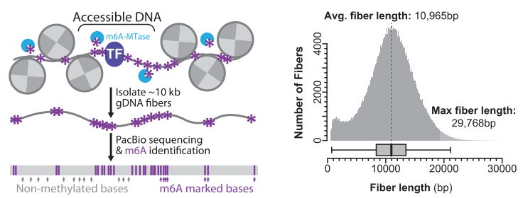
Detection of m6A with CCS
Single-molecule regulatory architectures captured by chromatin fiber sequencing Stergachis et al. Science (2020)
DnaseI-seq.
Fiber-seq.

Slide 31
Detection of m6A with CCS
Single-molecule regulatory architectures captured by chromatin fiber sequencing Stergachis et al. Science (2020)
Notes:
Representative genomic locus comparing the relationship between DNase I–seq, AdMTase-seq, and Fiber-seq at neighboring DHSs exposes the predominant all-or-none actuation of individual DHSs.

Slide 32
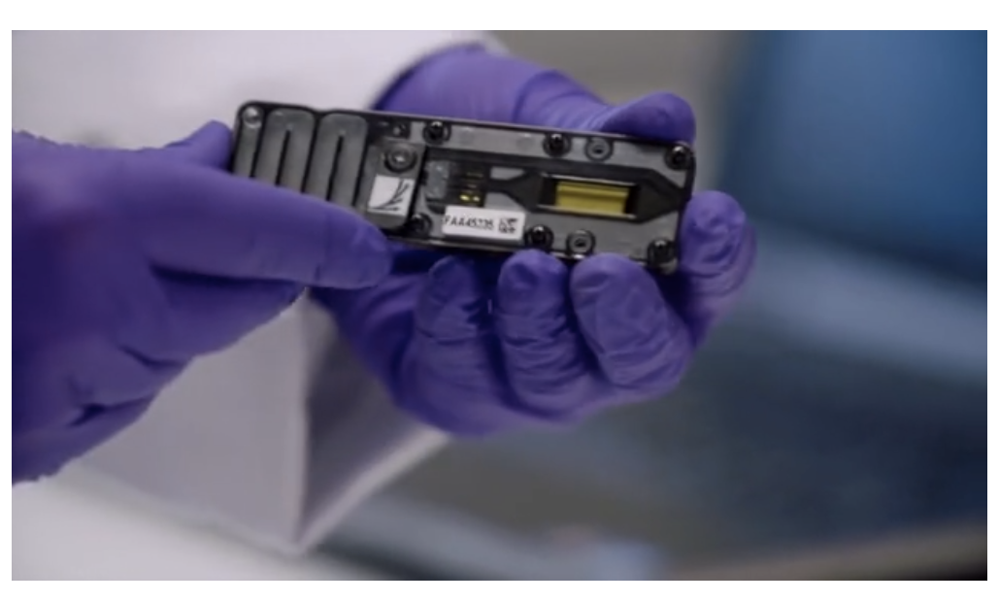

Slide 33
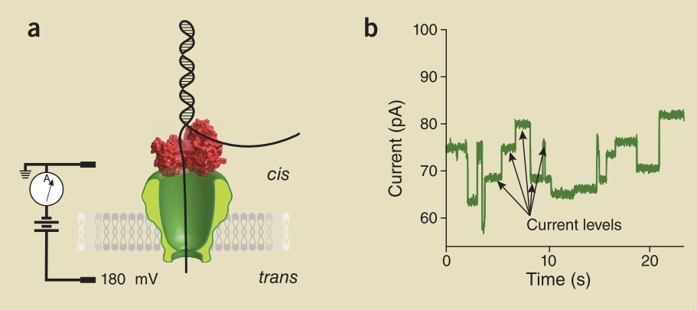
BASIC CONCEPTS
DNA polymerase
or helicase ratchets
DNA through the pore
one base per step
E. Coli amyloid
secretion channel
CsgG
450 b/sec
5’

Slide 34
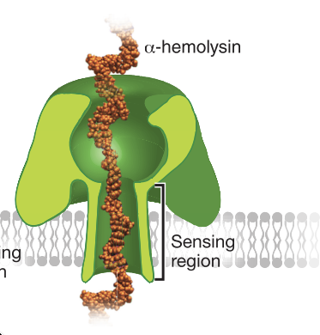
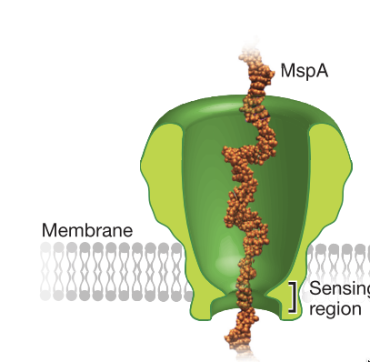
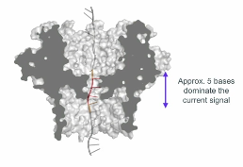
NANOPORES USED IN THE MinION
1996
2012
2017
alpha-hemolysin from
Staphylococcus aureus
Porin from
Mycobacterium smegmatis
E. Coli amyloid
secretion channel
CsgG
450 b/sec
Large
sensing region
Short
sensing region
MinION available
DNA transport
through alpha-hemolysin
Single nucleobase discrimination in a DNA strand
DNA sequencing
with phi29 DNA pol.
and MspA pore
E. coli assembled
de novo

Slide 35
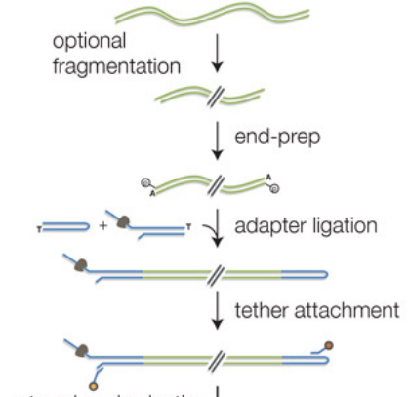
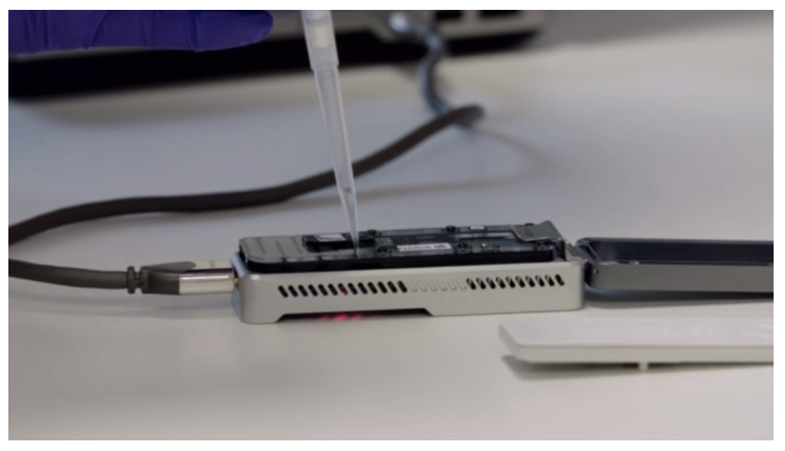
SEQUENCING PROCESS
1D² Library
(2017)
SEQUENCING

Slide 36
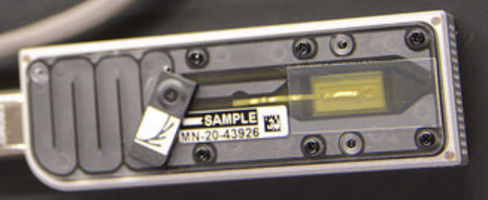
SEQUENCING PROCESS : MinION FLOW CELL
5-6 bases dominate the current signal
MinION : 512 pores
512 X 4 pores
current (pA)
time
PromethION : 144000 pores (48 x 3000)

Slide 37
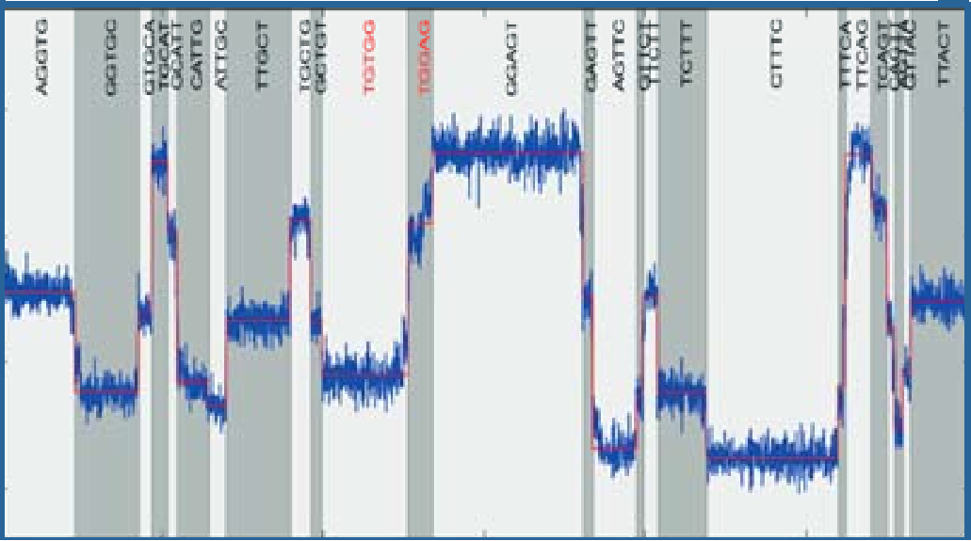
BASECALLING
….
time
….
current (pA)
hexamer
G A T C T G A GG A T G T C A G T G C C A T T
3000 values/s
GCTATG
TATGTC
AGGTGC
CTATGT
GGTGCT
GTGCTA
TGCTAT
5’
3’
……
……
Basecalling : finding the optimal
path of successive 6-mers
….. AGGTGCTATGTCT….

Slide 38
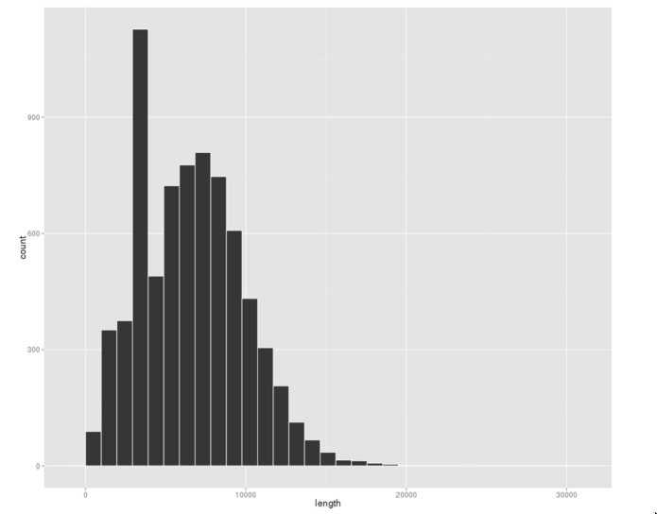
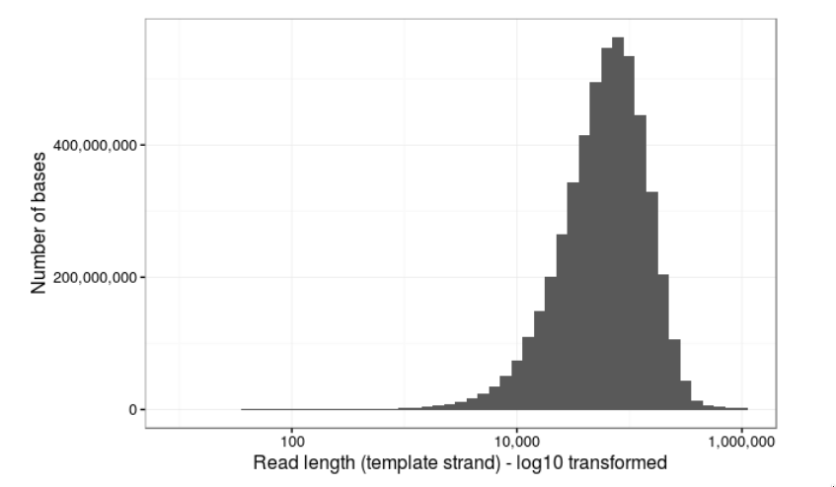
Size of sequenced DNA fragments
SIZE OF SEQUENCED DNA FRAGMENTS
“Poor quality” profile of fragment size
“Ultra long” reads
(lab.loman.net, March 2017)
0
10
20
Length of sequenced fragments (kb)
(Risse et al. GigaScience, 2015)
Size of the longest read : 778 kb

Slide 39
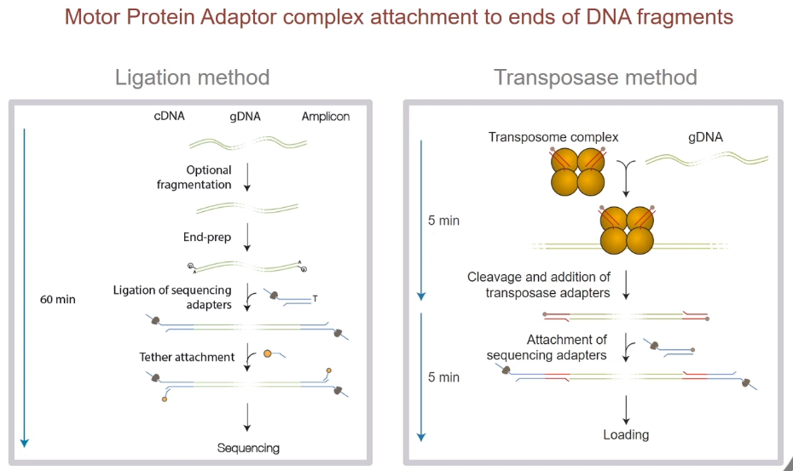
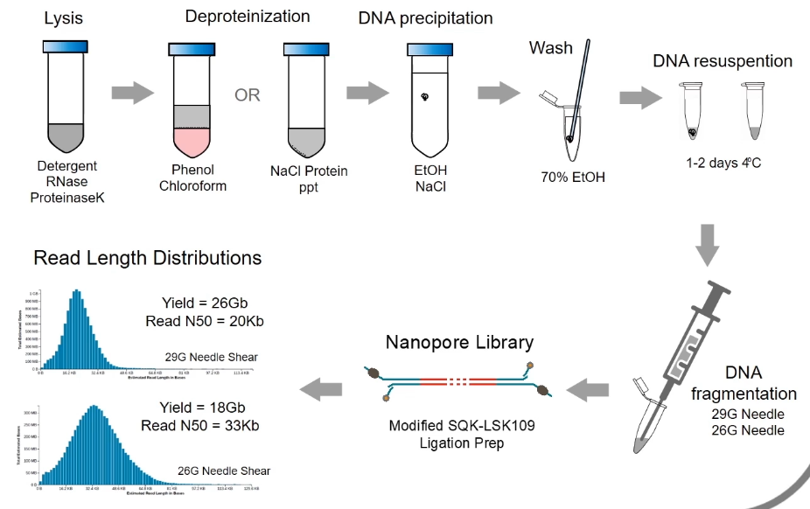
SIZE OF SEQUENCED DNA FRAGMENTS

Slide 40
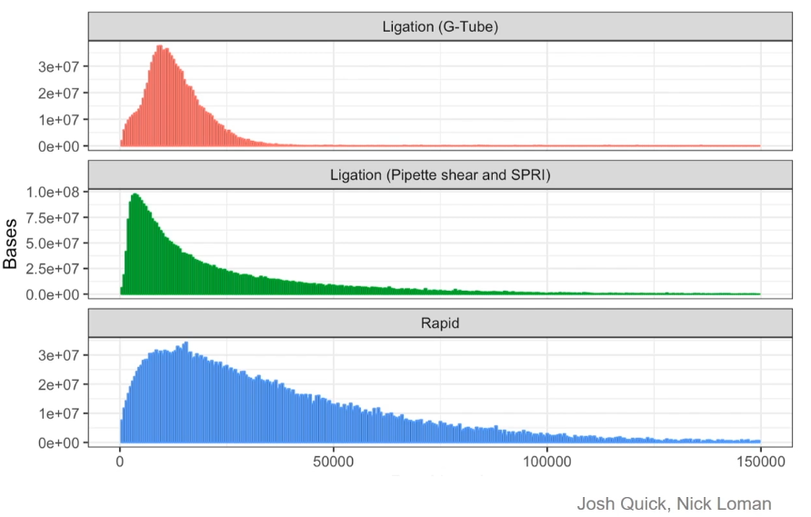
SIZE OF SEQUENCED DNA FRAGMENTS
see John Tyson’s video (ONT website)

Slide 41
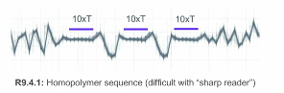
READ QUALITY
Homopolymers difficult to sequence

Slide 42
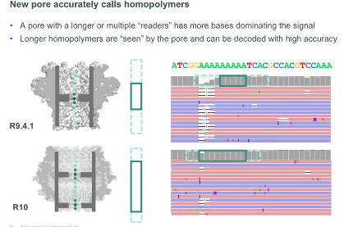
”Two readers” nanopore
“One-reader” pore has difficulty to read homopolymers
R9.4.1
2019
R10
“two-readers”

Slide 43
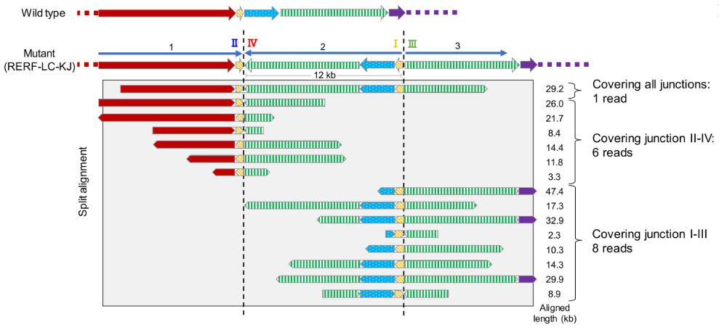
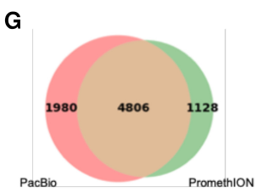
GENOME SEQUENCING
Long-read sequencing for non-small-cell lung cancer genomes
Sakamoto et al. Genome Research, Sept. 2020
Nanopore sequencing of cancer cell lines (Promethion)
Maximum length : 0.99 Mb
N50 : 32 kb
Average mapped reads : 14 kb
Biological relevance of SV further revealed by :
epigenome,
transcriptome,
protein analyses
Sequencing of clinical tumor samples
Structural aberrations also found in clinical lung adenocarcinoma specimens
Structural variants : comparison with PacBio sequencing
“These results indicated that neither the PacBio nor the PromethION platform is currently perfect; therefore, they should be used to complement each other.”

Slide 44
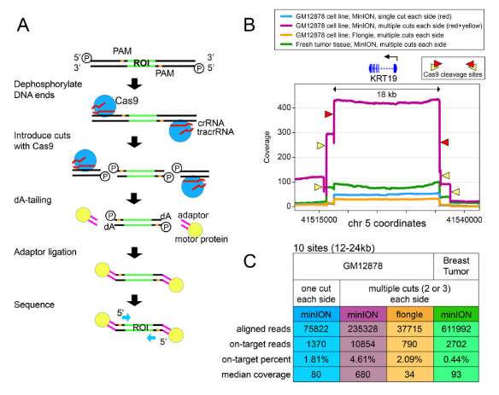
GENOME SEQUENCING : TARGETED SEQUENCING
Targeted nanopore sequencing with Cas9-guided adaptor ligation
Gilpatrick et al. Nature Biotechnology April 2020
nCATS = nanopore Cas9-targeted sequencing : enrichment strategy using targeted cleavage of DNA to ligate adapters for nanopore
nCATS can simultaneously assess :
haplotype-resolved single-nucleotide variants (SNVs)
structural variations (SVs)
CpG methylation…
Best median sequencing coverage : 680 X
nCATS uses only ~3 μg of genomic DNA + can target a large number of loci in a single reaction.

Slide 45
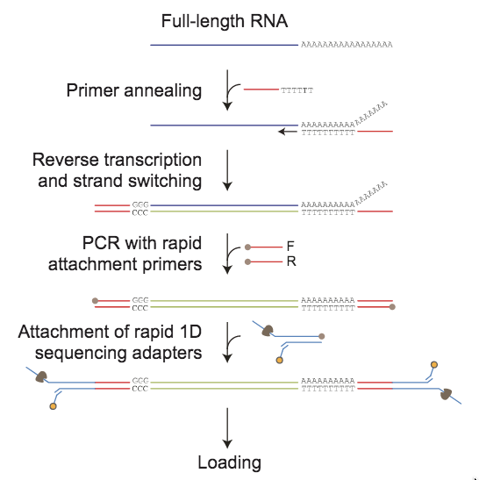
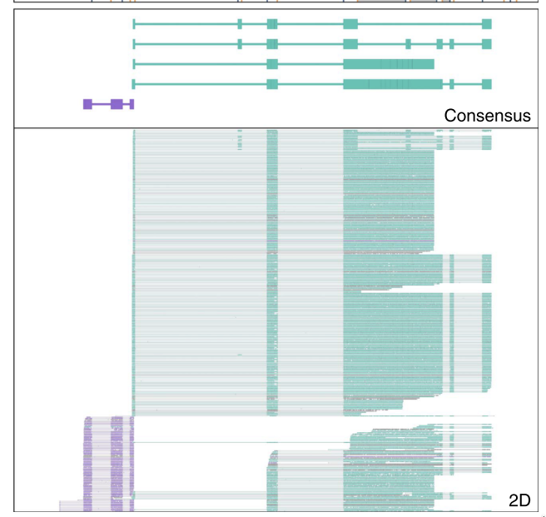
cDNA SEQUENCING
Library preparation
Detection of splice variants in surface receptor of B cells
(Byrne et al. Nat. Comm. 2017)
sequencing
Splice alignment uneasy due to high (5-10%) error rate
Reads are frequently truncated from 5’ end

Slide 46
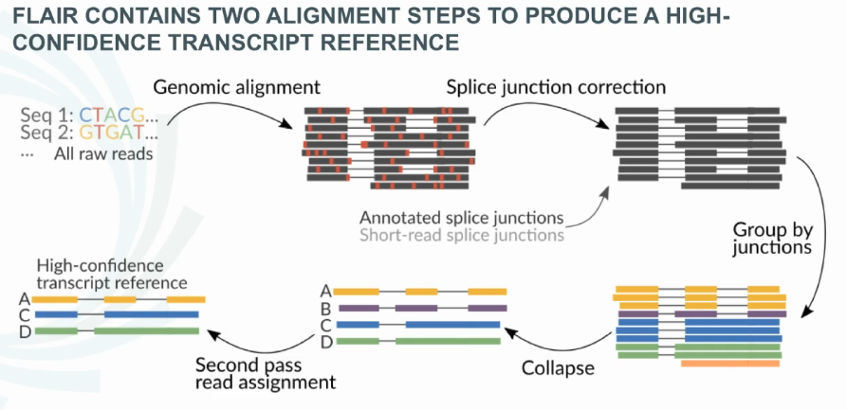
CHALLENGES OF NANOPORE TRANSCRIPTOME ANALYSIS
FLAIR : a pipeline for splicing isoform determination
Tang et al. bioRxiv 2018
FLAIR incorporates promoter chromatin states to distinguish 5’ truncations from true novel start sites
cDNA from chronic lymphocytic leukemia (CLL)

Slide 47
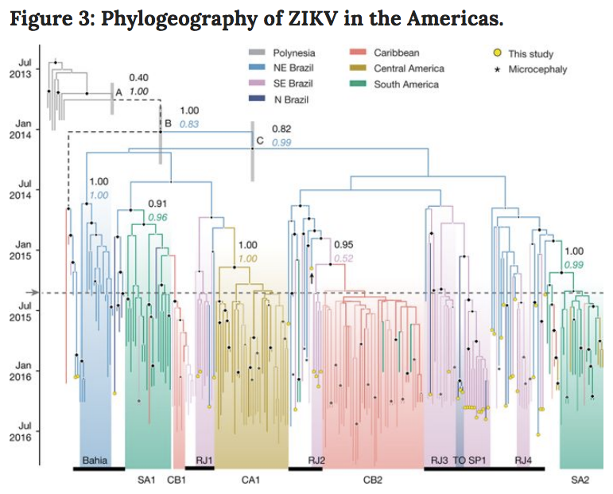
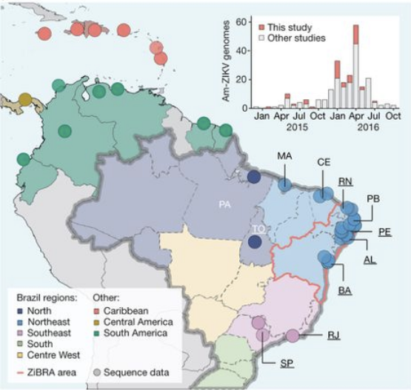
cDNA SEQUENCING
Faria et al. Nature (2017)
THE ZIBRA PROJECT : Establishment and cryptic transmission of Zika virus in Brazil and the Americas
Mobile genomics laboratory that travelled through northeast Brazil during June 2016.
The ZiBRA laboratory screened 1,330 samples (blood) from patients in 82 municipalities across 5 federal states
The MinION protocol does not require an Internet connection for analysis, making it suitable for field applications
Viral RNA genome : + sense, 10 kb
Viral consensus sequences can be achieved in 1-2 days.
ZIKV was present in northeast Brazil by February 2014 and has disseminated from there, nationally and internationally.

Slide 48
NANOPORE and SINGLE CELL cDNA SEQUENCING
High-throughput targeted long-read single cell sequencing reveals the clonal and transcriptional landscape of lymphocytes
Singh et al., bioRxiv, 2018
RAGE-seq (Repertoire And Gene Expression sequencing) : combines targeted long-read sequencing with short-read transcriptome of barcoded single cell libraries
10x Chromium Single Cell 3’
(V2 chemistry)
T or B cell antigen receptor mRNA
Tracking of somatic mutation, alternate splicing and clonal evolution of T and B lymphocytes
BUT
Does not correct for PCR biases

Slide 49
NANOPORE and SINGLE CELL cDNA SEQUENCING
High-throughput targeted long-read single cell sequencing reveals the clonal and transcriptional landscape of lymphocytes
Lebrigand et al., Nature Communications, 2020
ScNaUmi-seq : Single-cell Nanopore sequencing with UMIs (10x Genomics Chromium system)
High accuracy cellBC and UMI assignment
Analysis of splicing and sequence variation at the single-cell level

Slide 50
DETECTION OF MODIFIED BASES
Electric signal
Canonical base distribution

Slide 51
DETECTION OF MODIFIED BASES IN CANCER GENOMES
Same-day genomic and epigenomic diagnosis of brain tumors (gliomas, medulloblastomas)
with nanopore sequencing
Euskirchen et al., Acta Neuropathol. (2017)
analysis (5-6 hours)
Same-day detection of :
structural variants
point mutations
methylation profiling
Single device with negligible capital cost :
outperforms hybridization-based and current sequencing technologies
makes precision medicine possible for every cancer patient

Slide 52
DIRECT RNA SEQUENCING
Library preparation
RNA directly sequenced in nanopore
sequencing

Slide 53
DIRECT RNA SEQUENCING : CONTROLS
RNA spike in
Garalde et al. Nat. Methods 2018

Slide 54
DIRECT RNA SEQUENCING vs ILLUMINA
Nanopore
direct RNA
Illumina
Nanopore RNA direct
(read number ; Log scale)
Illumina Truseq
Sessegolo et al. Sci. Reports 2019

Slide 55
DIRECT RNA SEQUENCING: INFLUENZA VIRUS GENOME
Direct RNA Sequencing of the complete Influenza A Virus Genome
Keller et al. Scientific Reports, Sept. 2018
For the first time a complete genome of an RNA virus sequenced in its original form
Influenza A viruses are negative-sense segmented RNA viruses (8 segments)
sequencing of complete genome with 100% nucleotide coverage, 99% consensus identity
Potential to identify and quantify splice variants, base modifications
not practically measurable with current methods

Slide 56
DIRECT RNA SEQUENCING: TRANSCRIPT HAPLOTYPE
Nanopore native RNA sequencing of a human transcriptome
34 genes with discordant allele specificity in two isoforms
Workman et al.Nat. Methods (2019)

Slide 57
DIRECT RNA SEQUENCING: DETECTION OF m6A
Library preparation
Lorenz et al. RNA 2019
Detection of m6A with Nanopolish :
Different detection efficiency in different sites: 45% to 82%
Context dependent detection efficiency

Slide 58
DIRECT RNA SEQUENCING : detection of pseudo U
Naquin D, Gorrichon K & Costa M. I2BC Sequencing Platform 2020
1. In vitro synthesis of RNA molecules containing pseudo-U at fixed positions
pseudo U

Slide 59
DIRECT RNA SEQUENCING : detection of pseudo U
2. Re-squiggle (Tombo)
Re-squiggle: re-segmentation of the current profile
Dwell time
Current value

Slide 60
DIRECT RNA SEQUENCING : detection of pseudo U
2. Re-squiggle (Tombo)
Re-squiggle: re-segmentation of the current profile

Slide 61
DIRECT RNA SEQUENCING : detection of pseudo U
3. Detection: KS statistics (Kolmogorov-Smirnov)
(Nanopolish)
Dwell time
Current value
Low detection efficiency : Sn and Sp : 30 – 50 %

Slide 62
DIRECT RNA SEQUENCING : detection of pseudo U
Alternative strategy : detection using base calling mis-assignement
(Minimap2)
pseudo U
Detection : strongly context dependent
psi1
psi2
psi1
psi2
error of base calling

Slide 63
Recent advances

Slide 64
Recent advances : Assembly of PacBio HiFi reads with HiCANU
HiCanu: accurate assembly of segmental duplications, satellites, and allelic variants from high-fidelity long reads
Nurk al. Genome Research Sept. 2020

Slide 65
Recent advances : Nanopore and 10x Genomics Visium
The spatial landscape of gene expression isoforms in tissue sections
Lebrigand et al., bioRxiv, 2020
Spatial Isoform Transcriptomics (SiT) : Genome-wide approach to explore and discover in a tissue context :
Isoform expression (bi-allelic expression)
Sequence heterogeneity (SNP expression)

Slide 66
Recent advances : Illumina sequencing with Smart-seq3
Single-cell RNA counting at allele- and isoform-resolution using Smart-seq3
Hagemann-Jensenn et al. Nature Biotechnology, 2020
Dimensionality reduction of 3,890 human cells colored by annotated cell type
Count RNA molecules at allelic and transcript isoform resolution
Smart-seq3 :
full-length transcriptome coverage
5′ UMI RNA in silico reconstruction of thousands of RNA molecules/cell
60% assignments to allelic origin
30–50% assignments to specific isoforms
Smart-seq3 greatly increased sensitivity compared to Smart-seq2 detecting thousands more transcripts/cell

Slide 67
The structure, function, and evolution of a complete human chromosome 8
Logsdon et al., bioRxiv, Sept 2020
First complete linear assembly of a human autosomal chromosome.
It resolves the sequence of five previously long-standing gaps :
2.08 Mbp centromeric α-satellite array
644 kbp defensin copy number polymorphism
863 kbp variable number tandem repeat at chromosome 8q21.2 (neocentromere)
Etc..
Barcoded Ultra-long Nanopore reads assembled into a scaffold
Regions within the scaffold with high sequence identity with PacBio HiFi contigs are replaced, thereby improving the base accuracy to >99.99%.

Slide 68
Summary
PacBio
Maximum read length : 200 kb
CCS sequencing (HiFI reads) :
Very low error rate, better genome assembly
Sequencing of cDNAs (resolution of alternative splicing)
Detection of modified DNA (6mA >> 5mC)
Nanopore
Very light sequencing system
Very long reads : maximum length >> 200 kb
Detection of modified DNA (5mC >> 6mA)
Direct sequencing of RNA :
Direct RNA-seq
Detection of modified RNA (6mA, pseudo U)
Illumina
Reconstruction of complete cDNAs with Smartseq3 :
Reconstruction of thousands of RNA molecules per cell
RNA quantification at allele and isoform resolution
PacBio
Illumina
Nanopore

